Slide 1
Thank you for downloading!
Hope it helps you with your presentations!
In case the Genshin font (HYWenHei) doesnt work, try installing it onto your computer!
https://www.fontshore.com/genshin-impact-font

Slide 2

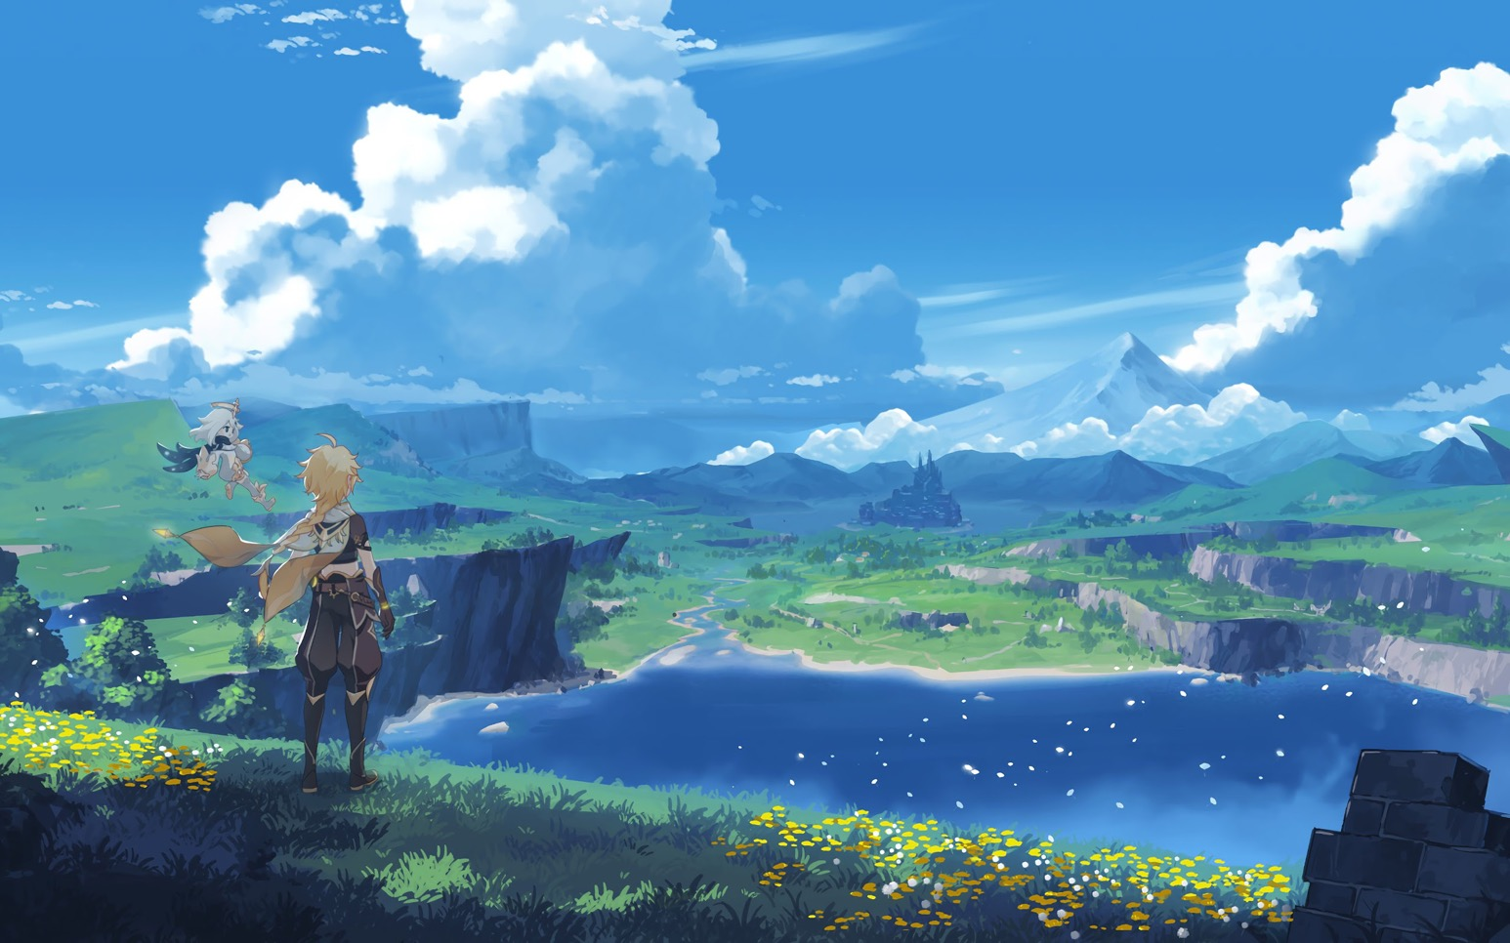
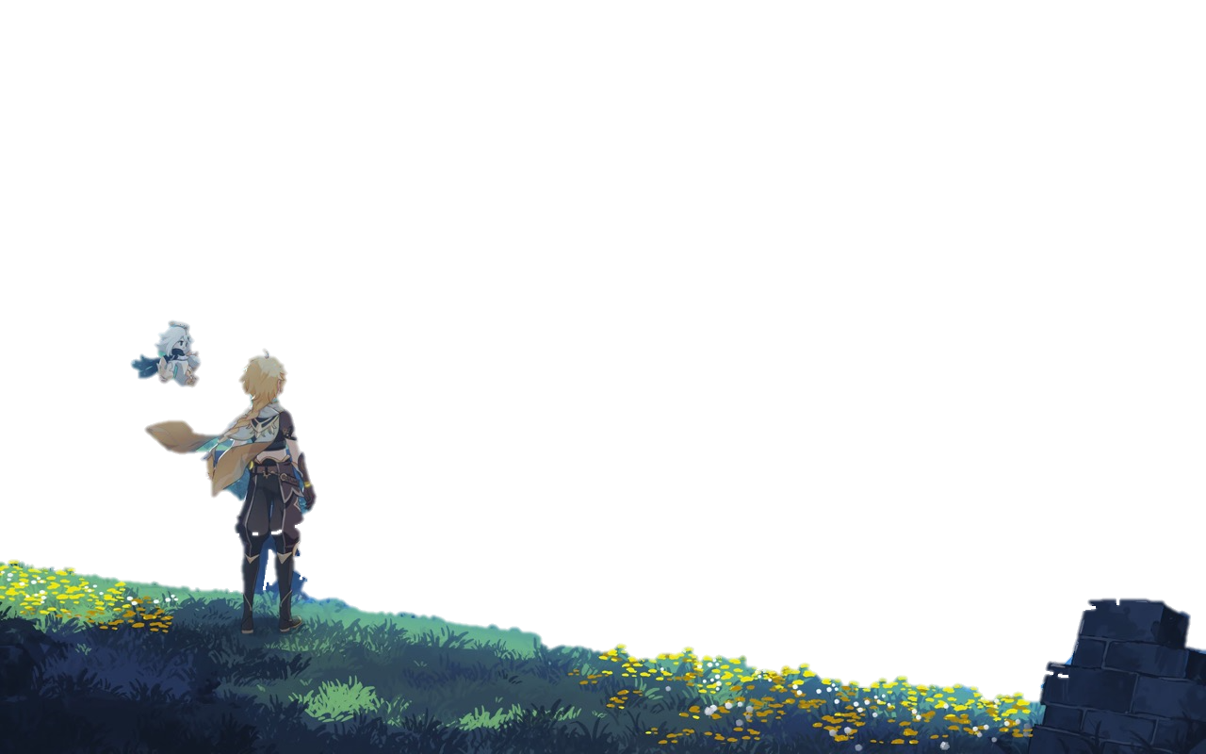
Mondstadt

Slide 3
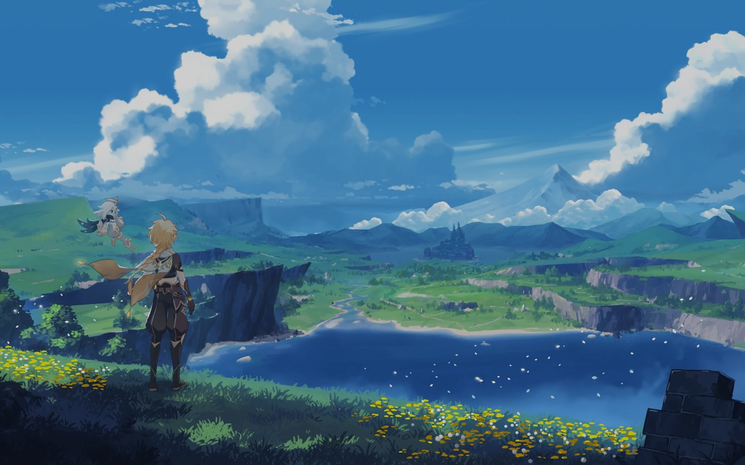
Mondstadt
City of Freedom • Travel Guide

Slide 4










Mondstadt
Travel Guide
Overview
Geography
A city of freedom that lies in the northeast of Teyvat.
From amongst mountains and wide-open plains, carefree breezes carry the scent of dandelions — a gift from the Anemo God, Barbatos — across Cider Lake to Mondstadt, which sits on an island in the middle of the lake.
Landmarks
Festivals
Cuisine
Architecture

Slide 5


Geography
Travel Guide
Overview
Geography
Under Barbatos' blessing, most of Mondstadt has a gentle climate that allows crops to flourish. Fresh fruits such as sunsettias and apples are abundant, as well as grapes for making wine.
Of the wineries in Mondstadt, the Dawn Winery is one of the oldest and most influential, with over a thousand years of history.
Landmarks
Festivals
Cuisine
Architecture

Slide 6



Geography
Lush and green landscapes
Tall and steep cliffs
Ancient ruins
Rolling hills

Slide 7





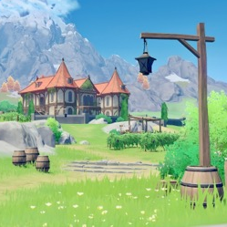

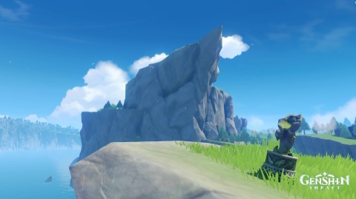
Must-Visit Landmarks
Springvale
Dawn Winery
Cider Lake
Cape Oath
A sleepy little village to the south of Mondstadt, that sits facing the lake that surrounds the city.
Passed down the legacy of Mondstadt's traditional wines and ciders for generations.
The lake is so clear that you can see the bottom, and cool and refreshing to drink.
Legend has it two lovers made an oath to each other here, making the area popular among couples.

Slide 8


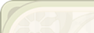


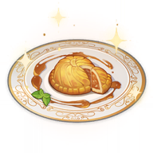


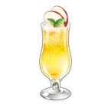

Must-Try Local Dishes
“Pile‘Em Up”+ Fruits of the Festival
A rich, meaty dish synonymous with Ludi Harpastum.
Moon Pie + Wolfhook Juice
A traditional staple not to be missed at any festival.
Mondstadt Hash Browns + Apple Cider
A little bit of pinecone helps give it a nice crunch.

Slide 9
Must-Try Local Dishes
“Pile‘Em Up”+ Fruits of the Festival
A rich, meaty dish synonymous with Ludi Harpastum.
Moon Pie + Wolfhook Juice
A traditional staple not to be missed at any festival.
Mondstadt Hash Browns + Apple Cider
A little bit of pinecone helps give it a nice crunch.

Slide 10
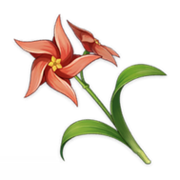
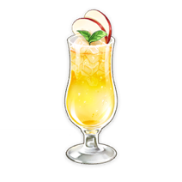

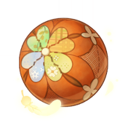
Festivals
Windblume Festival
Ludi Harpastum
Weinlesfest
Making new wine and inviting the Anemo Archon to drink
Celebration of love and friendship
15 days of games for children

Slide 11
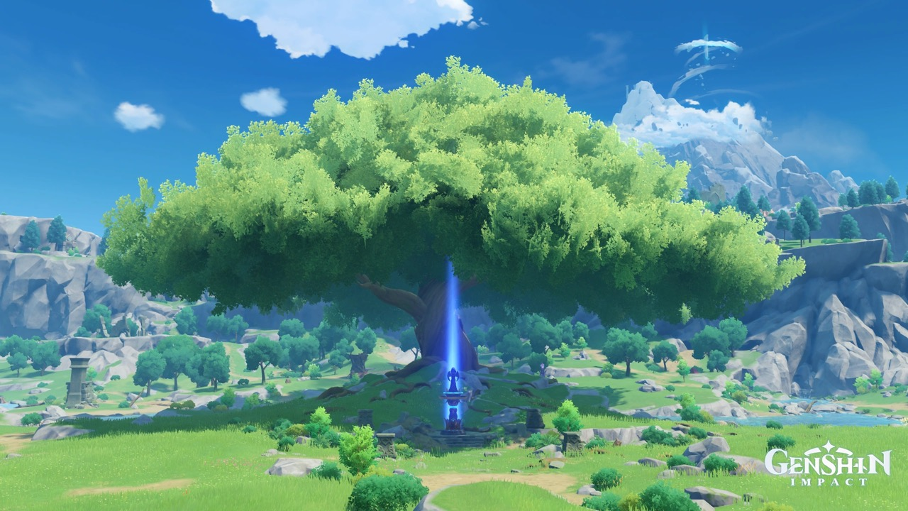
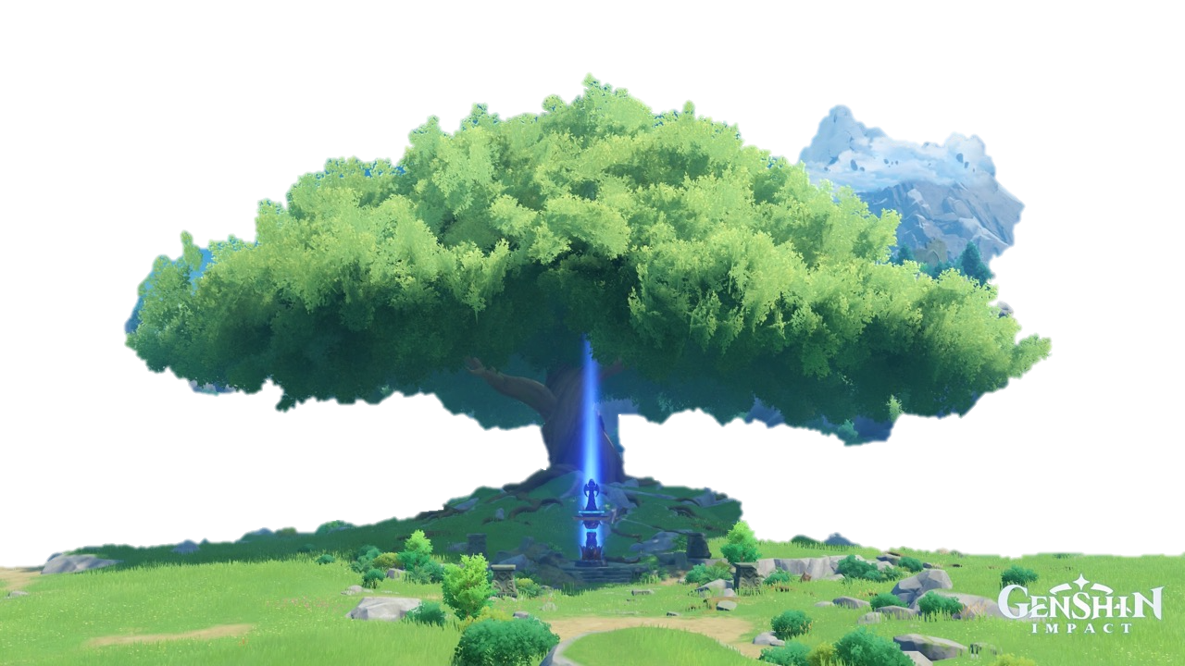
Visit soon!
Visit soon!

Slide 12




Visit soon!
Visit soon!

